Slide 1
第十九章 代理模式
代理模式
为其他对象提供一种代理以控制对这个对象的访问。
Proxy Pattern
Provide a surrogate or placeholder for another object to control access to it.

Slide 2
一 、 概述
代理模式是为对象提供一个代理，代理可以控制对它所代理的对象的访问。
代理模式最常见的两种情况：远程代理和虚拟代理。

Slide 3
二、代理模式的结构与使用
模式的结构中包括三种角色：
抽象主题（Subject）
实际主题（RealSubject）
代理（Proxy）

Slide 4
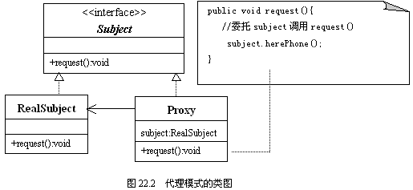
模式的UML类图

Slide 5
模式的结构的描述与使用
1．抽象主题（Subject）: Geometry.java
public interface Geometry{
public double getArea();
}

Slide 6
模式的结构的描述与使用
2．具体模板（Concrete Template）: Trangle.java
public class Triangle implements Geometry{
double sideA,sideB,sideC,area;
public Triangle(double a,double b,double c) {
sideA=a;
sideB=b;
sideC=c;
}
public double getArea(){
double p=(sideA+sideB+sideC)/2.0;
area=Math.sqrt(p*(p-sideA)*(p-sideB)*(p-sideC)) ;
return area;
}
}

Slide 7
模式的结构的描述与使用
3．代理（Proxy）：TriangleProxy.java
public class TriangleProxy implements Geometry{
double sideA,sideB,sideC;
Triangle triangle;
public void setABC(double a,double b,double c) {
sideA=a;
sideB=b;
sideC=c;
}
public double getArea(){
if(sideA+sideB>sideC&&sideA+sideC>sideB&&sideB+sideC>sideA){
triangle=new Triangle(sideA,sideB,sideC);
double area=triangle.getArea();
return area;
}
else
return -1;
}
}

Slide 8
模式的结构的描述与使用
4．应用 Application.java
import java.util.Scanner;
public class Application{
public static void main(String args[]) {
Scanner reader=new Scanner(System.in);
System.out.println("请输入三个数，每输入一个数回车确认");
double a=-1,b=-1,c=-1;
a=reader.nextDouble();
b=reader.nextDouble();
c=reader.nextDouble();
TriangleProxy proxy=new TriangleProxy();
proxy.setABC(a,b,c);
double area=proxy.getArea();
System.out.println("面积是："+area);
}
}

Slide 9
三、代理模式的优点
代理模式可以屏蔽用户真正请求的对象，使用户程序和真正的对象之间解耦。
使用代理来担当那些创建耗时的对象的替身。

Slide 10
Java
RMI
CDP Tutorial
Based on
Based on the slides of Alexander Day Chaffee

Slide 11
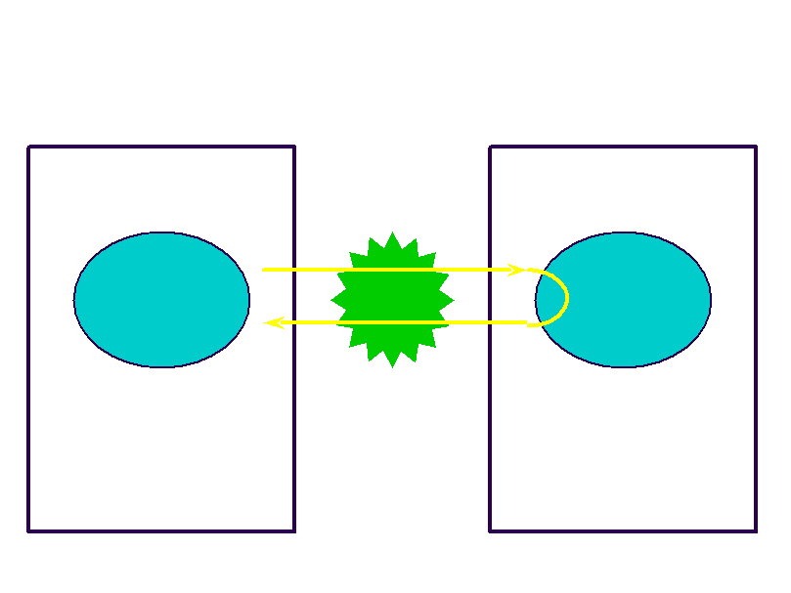
Remote Objects (Diagram)
Java Virtual Machine
Java Virtual Machine
Client
Object
Remote
Object
TCP

Slide 12
What is RMI?


RMI is an RPC system for an object based
language.
Objects provide a natural granularity for the
binding of functions.

RMI allows a program to hold a reference to an object
on a remote system and to call that object’s methods.

Client-Server architecture.


Server holds the object.
Client holds a small stub that accesses the object on
the Server.

Slide 13
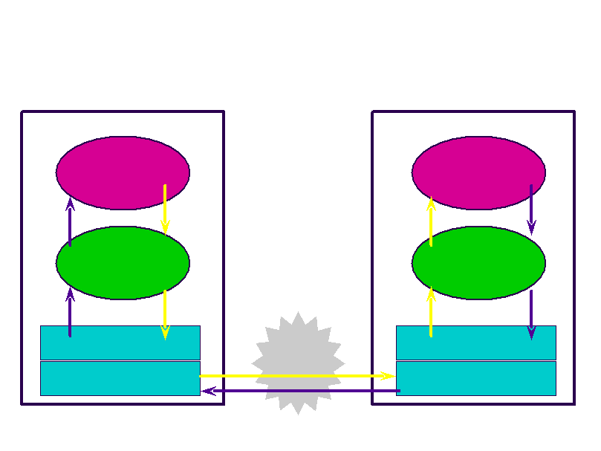
RMI Layers
Java Virtual Machine
Client
Object
Stub
Remote Reference Layer
Java Virtual Machine
Remote
Object
Skeleton
Remote Reference Layer
TCP
Transport Layer
Transport Layer

Slide 14
Remote Objects

Remote Objects


Live on server
Accessed as if they were local

Slide 15
Remote References and
Interfaces

Remote References


Refer to remote objects
Invoked on client exactly like local object
references

Remote Interfaces



Declare exposed methods
Implemented on client
Like a proxy for the remote object

Slide 16
Stubs and Skeletons

Stub


lives on client
pretends to be remote object

Skeleton




lives on server
receives requests from stub
talks to true remote object
delivers response to stub

Slide 17
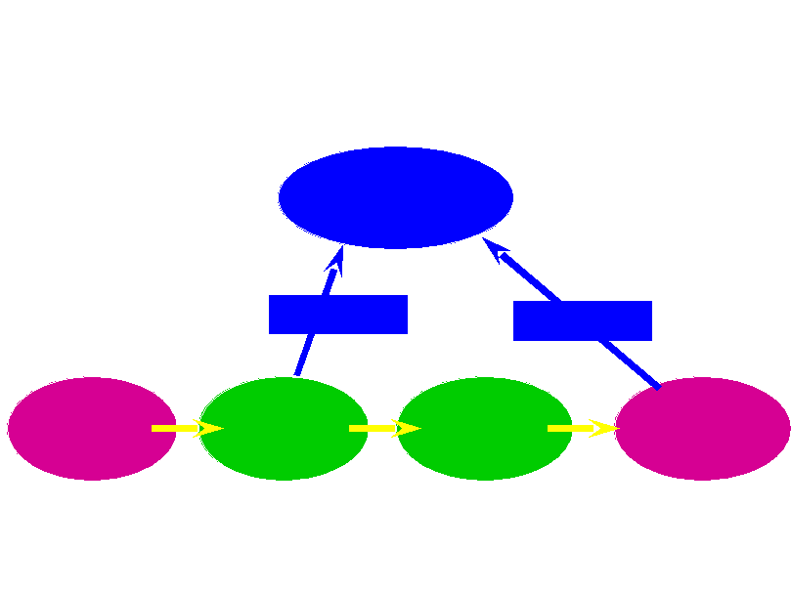
Remote Interfaces and Stubs
Remote Interface
implements
implements
Remote Object
(Server)
Client
Stub
Skeleton

Slide 18
Registries




Name and look up remote objects
Servers can register their objects
Clients can find server objects and obtain a
remote reference
A registry is a running process on a host
machine

Slide 19
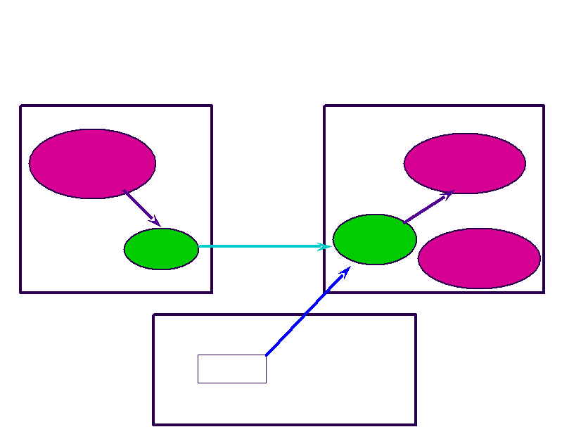
RMI System Architecture
Client Virtual Machine
Client
Server Virtual Machine
Remote
Object
Skeleton
“Fred”
Registry Virtual Machine
Stub
Server

Slide 20
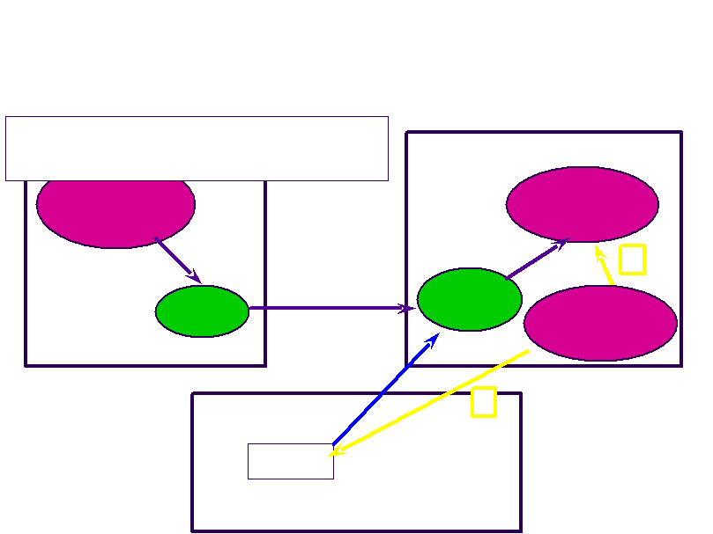
RMI Flow
1. Server Creates Remote Object
Client Virtual Machine
2. Server Registers Remote Object
Client
Server Virtual Machine
Remote
Object
1
Skeleton
2
“Fred”
Registry Virtual Machine
Stub
Server

Slide 21
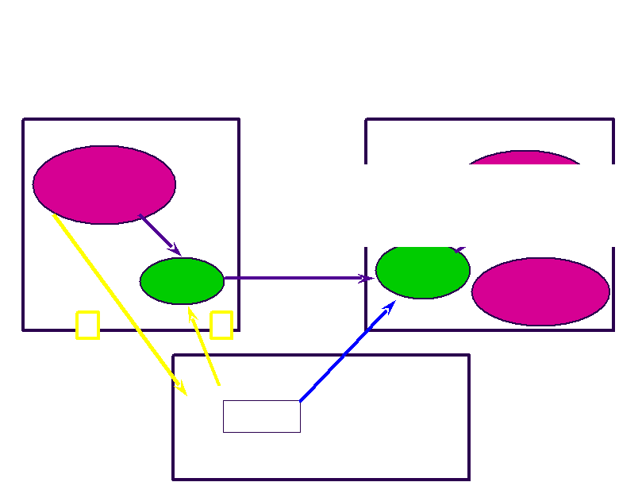

RMI Flow
Client Virtual Machine
Client
Server Virtual Machine
Remote
Object
(and stub gets created)
3. Client requests object from Registry
4. Registry returns remote reference
Skeleton
4
“Fred”
Registry Virtual Machine
Stub
Server
3

Slide 22
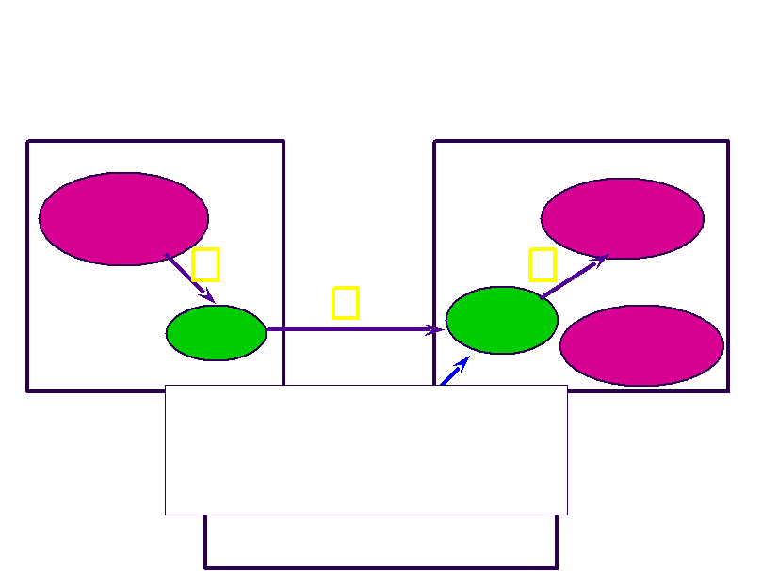
RMI Flow
Client Virtual Machine
Client
5
Server Virtual Machine
Remote
Object
7
6
Skeleton
Stub
Server
5. Client invokes stub method
6. Stub talks to skeleton
7. Skeleton invokes remote object
method“Fred”
Registry Virtual Machine

Slide 23
RMI Usage



Start registry
Start server
Run client

Slide 24
Creating Remote Objects

Define a Remote Interface

extends java.rmi.Remote

Define a class that implements the Remote
Interface


extends java.rmi.RemoteObject
or java.rmi.UnicastRemoteObject

Slide 25
Remote Interface Example
import java.rmi.*;
public interface Adder
extends Remote
{
public int add(int x, int y)
throws RemoteException;
}

Slide 26
Remote Class Example
import java.rmi.*;
import java.rmi.server.*;
public class AdderImpl extends UnicastRemoteObject
implements Adder
{
public AdderImpl() throws RemoteException
{
// NOTE: !!!EMPTY CONSTRUCTOR!!!
}
public int add(int x, int y) throws RemoteException
{
return x + y;
}
}

Slide 27
Registering Remote Classes

start the registry

running process


Unix:
rmiregistry &
Windows:
start /m rmiregistry

Slide 28
Registry CLASSPATH



Registry VM needs to be able to find stub
file(s)
You must set the CLASSPATH to include
the directory containing the stub file
An easy way to check CLASSPATH is to use the javap command,
supplying a fully package qualified class name. It uses the current
CLASSPATH to find and print the interface to a class.

Slide 29
Create the server



Creates a new instance of the remote
object
Registers it in the registry with a unique
name
That’s it

Slide 30
RMI Server Example
try {
AdderImpl adder = new AdderImpl();
Naming.rebind("adder", adder);
System.err.println(“Bind successful”);
}
catch (RemoteException re) {
re.printStackTrace();
}
catch (MalformedURLException me) {
me.printStackTrace();
}

Slide 31
Launch the Server
% java AdderServer
Bind successful

Slide 32
Server Logging

invoke from command line
java
-Djava.rmi.server.logCalls=true
YourServerImpl

or enable inside program
RemoteServer.setLog(System.err);

Slide 33
Creating an RMI Client

Find a registry

use java.rmi.Naming



Lookup the name, returns a reference
Cast the reference to the appropriate
Remote Interface
Just use it!

Slide 34
RMI URLs
rmi://host[:port]/name



default port is 1099
Specifies hostname of registry
can also use relative URLs


name only
assumes registry is on local host

Slide 35
RMI Client Example
Adder a = (Adder)//not AdderImpl
Naming.lookup("rmi://server/adder");
int sum = a.add(2,2);
System.out.println("2+2=" + sum);

Slide 36
Remote Interfaces vs. Remote
Classes




Remember that the reference is to an
interface
You must make references, arrays, etc. out
of the interface type, not the
implementation type
You can’t cast the remote reference to a
normal reference
So name your Remote Objects with “Impl”
(so you don’t get confused)

Slide 37
Parameter Passing

Primitive types

passed by value

Remote objects

passed by reference

Non-remote objects


passed by value
uses Java Object Serialization

Slide 38
Callbacks




They just work
Pass in a remote reference to a client
object
Server object can call its methods
transparently
Registry is out of the loop

Slide 39
Object Serialization




aka Persistence
saves the state (data) of a particular
instance of an object
serialize - to save
unserialize - to load

Slide 40
Java Serialization




writes object as a sequence of bytes
writes it to a Stream
recreates it on the other end
creates a brand new object with the old
data

Slide 41
java.io.Serializable






Objects that implement the
java.io.Serializable interface are marked as
serializable
Also subclasses
Magically, all non-static and non-transient
data members will be serialized
Actually, it’s not magic, it’s Reflection (it’s
done with mirrors)
empty interface - just a marker
It’s a promise

Slide 42
Not All Objects Are
Serializable


Any object that doesn’t implement
Serializable
Any object that would pose a security risk

e.g. FileInputStream

Any object whose value depends on VM-
specific information

e.g. Thread

Any object that contains a (non-static, non-
transient) unserializable object (recursively)

Slide 43
NotSerializableException


thrown if you try to serialize or unserialize
an unserializable object
maybe you subclassed a Serializable object
and added some unserializable members

Slide 44
Incompatible Changes


If class has members added or removed, it
becomes incompatible
java.io.InvalidClassException thrown if you
try to deserialize an incompatible object
stream

Slide 45
Limitations of RMI

Java-only

but you can use JNI on the server



Uses TCP, not UDP
At least two sockets per connection
Untested for huge loads

Slide 46
Summary



RMI is a very clean API
Easy way to write distributed programs
Wire protocol may need improvement for
large-scale problems

Slide 47
Where to get more
information






Harold, Java Network Programming
(O’Reilly)
rmi-users mailing list (rmi-users@javasoft.com)
http:/ / www.developer.com/ (Gamelan)
http:/ / www.javaworld.com/ (magazine)
http:/ / www.stinky.com/ java/ (Alexander
Day Chaffee's site)
Material from the previous semester

